Slide 1

Artificial intelligence robot
Under ground water and gas line problem detector, global control system ,gps location and home safety robot.

Slide 2
Robot's performance
Automatic gas and water line problem detector.
Detect problem distance like as x meter or kilometer.
Take problem a photo in pipeline problem area.
Print out the problem area picture and problem distance.
Home security guard robot.
Security alarm Capable robot.
Automatic light control video recorder system.
Online control system robot.
Any country available for control.

Slide 3



Online robot control system 1. Online control will be Computer, Smartphone or Joystick/Game controller. 2. The robot online control will be a database and online server. 3. Programmable controlling system

Slide 4
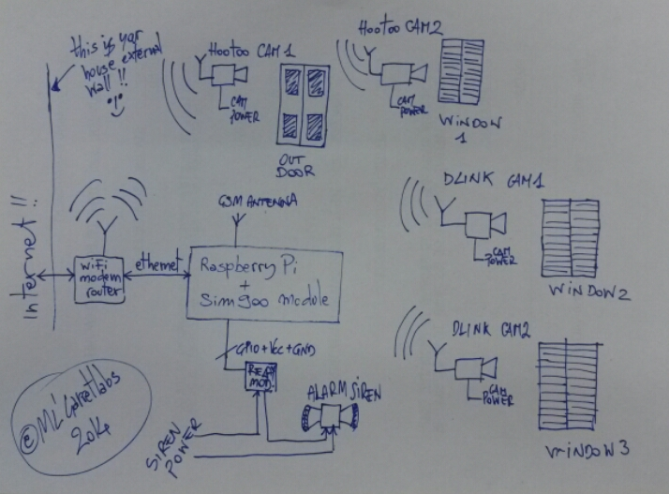
Online connection control circuit diagram

Slide 5
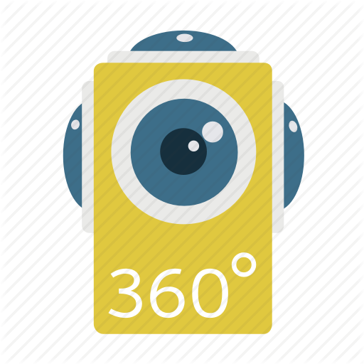
1.The robot will live stream and take picture. Send to be user data base and print out will be by printer. 2.The camera will be 350 degree rotational
Online Camera and video live stream

Slide 6
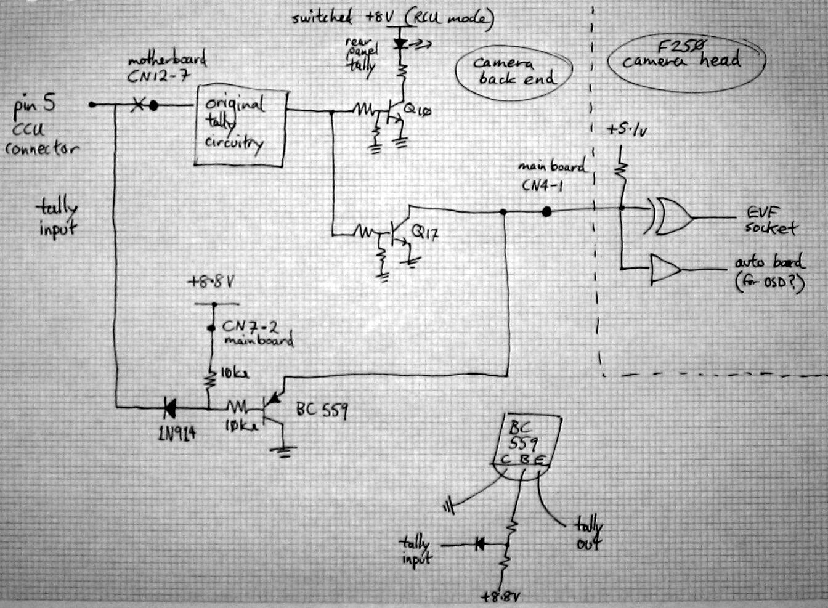
Online camera connection diagram

Slide 7

1. The motor driver will be controlled by the computer program. 2. how to run the robot will command by coding.
Motor driver controlled by computer program

Slide 8
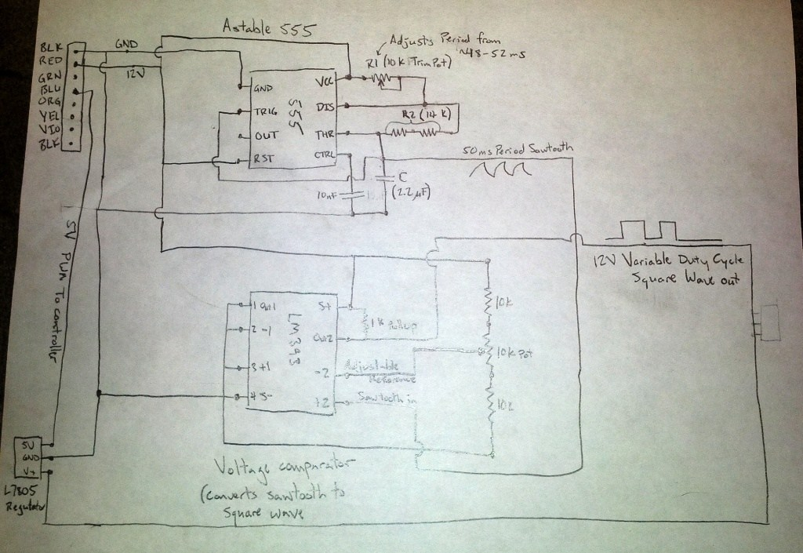
Motor driver connection circuit diagram

Slide 9

1. Gps locator system anyone control this robot any country. 2. Robot current location show by google map
The Robot is Gps location control available

Slide 10
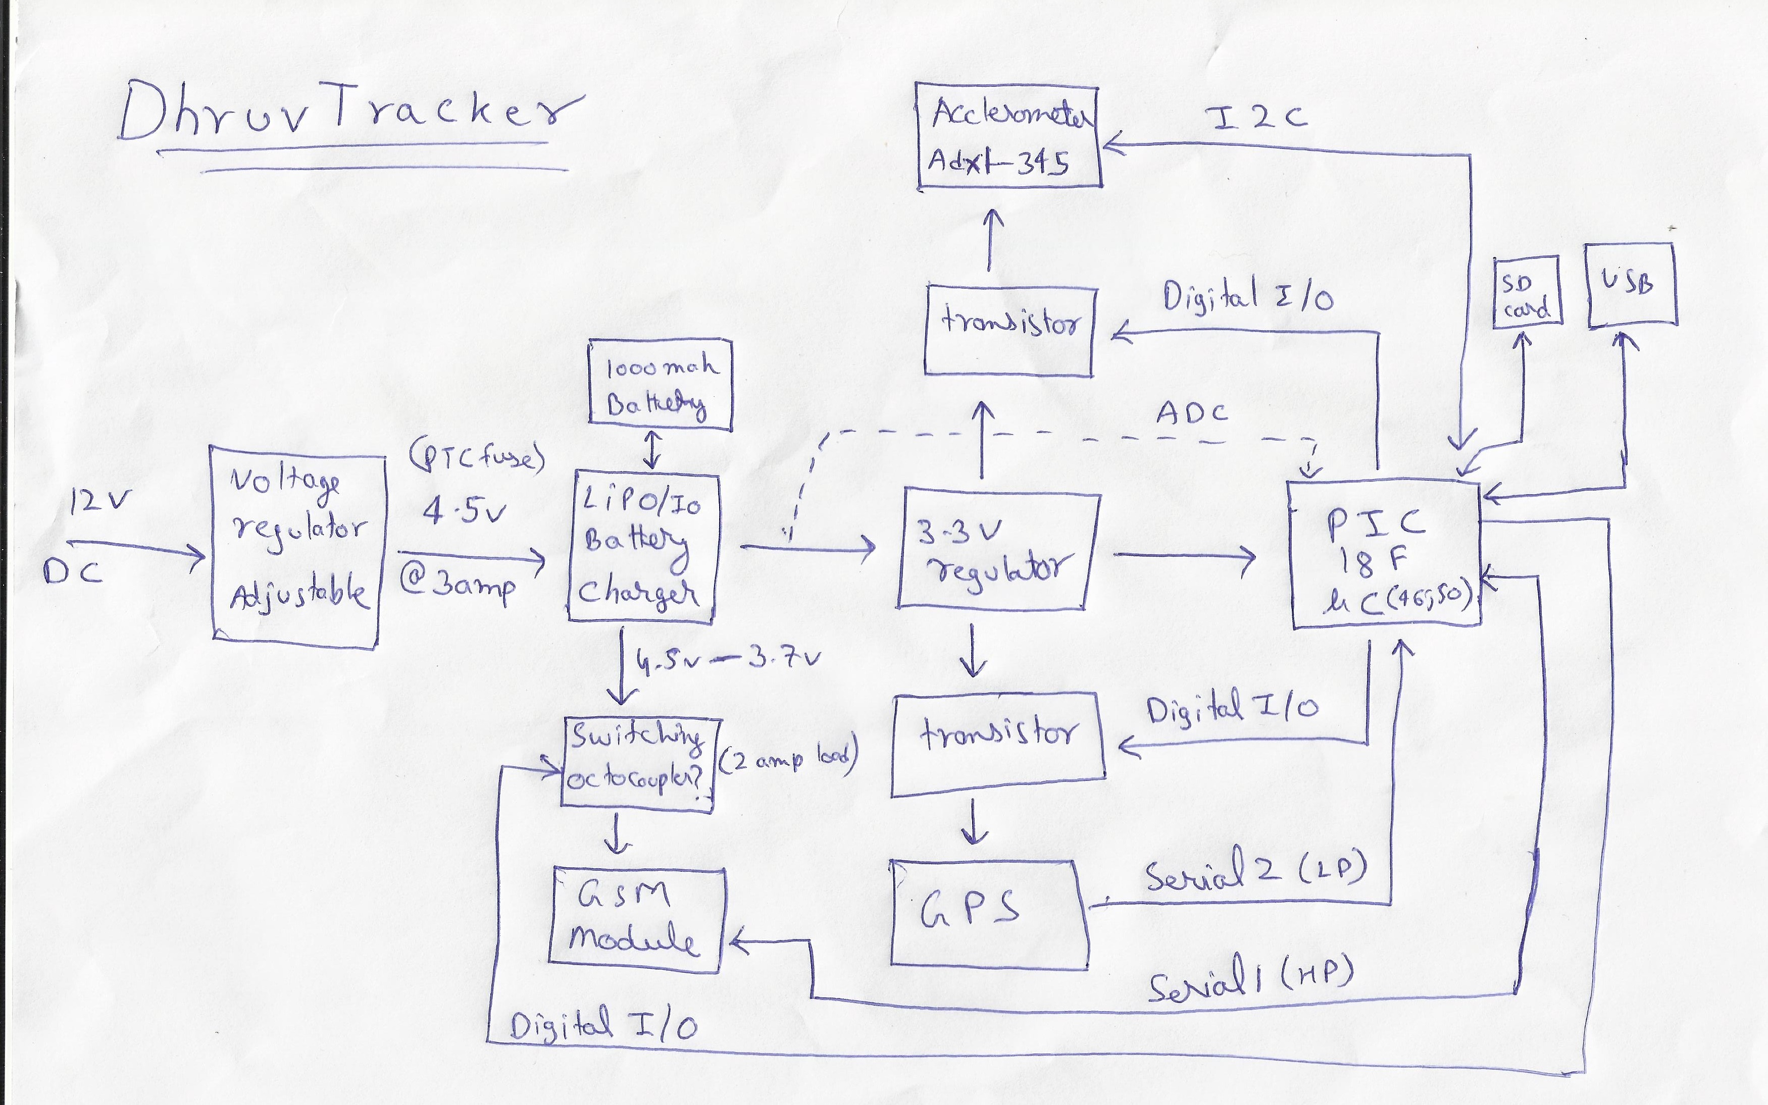
GPS locator system circuit diagram

Slide 11

1. A passive infrared sensor (PIR sensor) is an electronic sensor that measures infrared (IR) light radiating from objects in its field of view. They are most often used in PIR-based motion detectors. 2. The robot detect any object then alarm start and will be send information to database.
PIR sensor and security alarm relay controlling

Slide 12
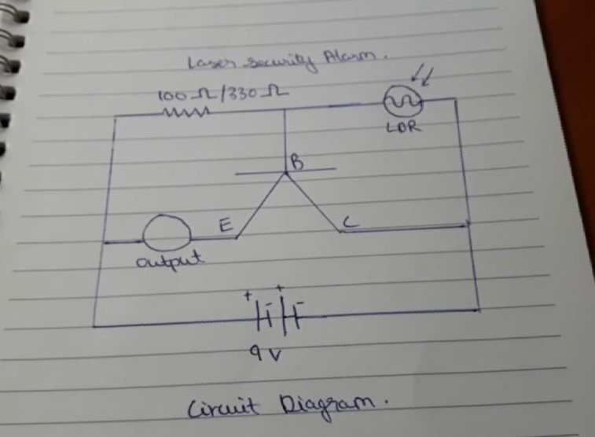
Security alarm circuit diagram

Slide 13
1. Video control Relays are switches that open and close circuits electromechanically or electronically. Relays control one electrical circuit by opening and closing contacts in another circuit. As relay diagrams show, when a relay contact is normally open (NO), there is an open contact when the relay is not energized. 2. The robot detect any object then video recording start and will be send to database.
Automatic detector sensor & video recorder

Slide 14
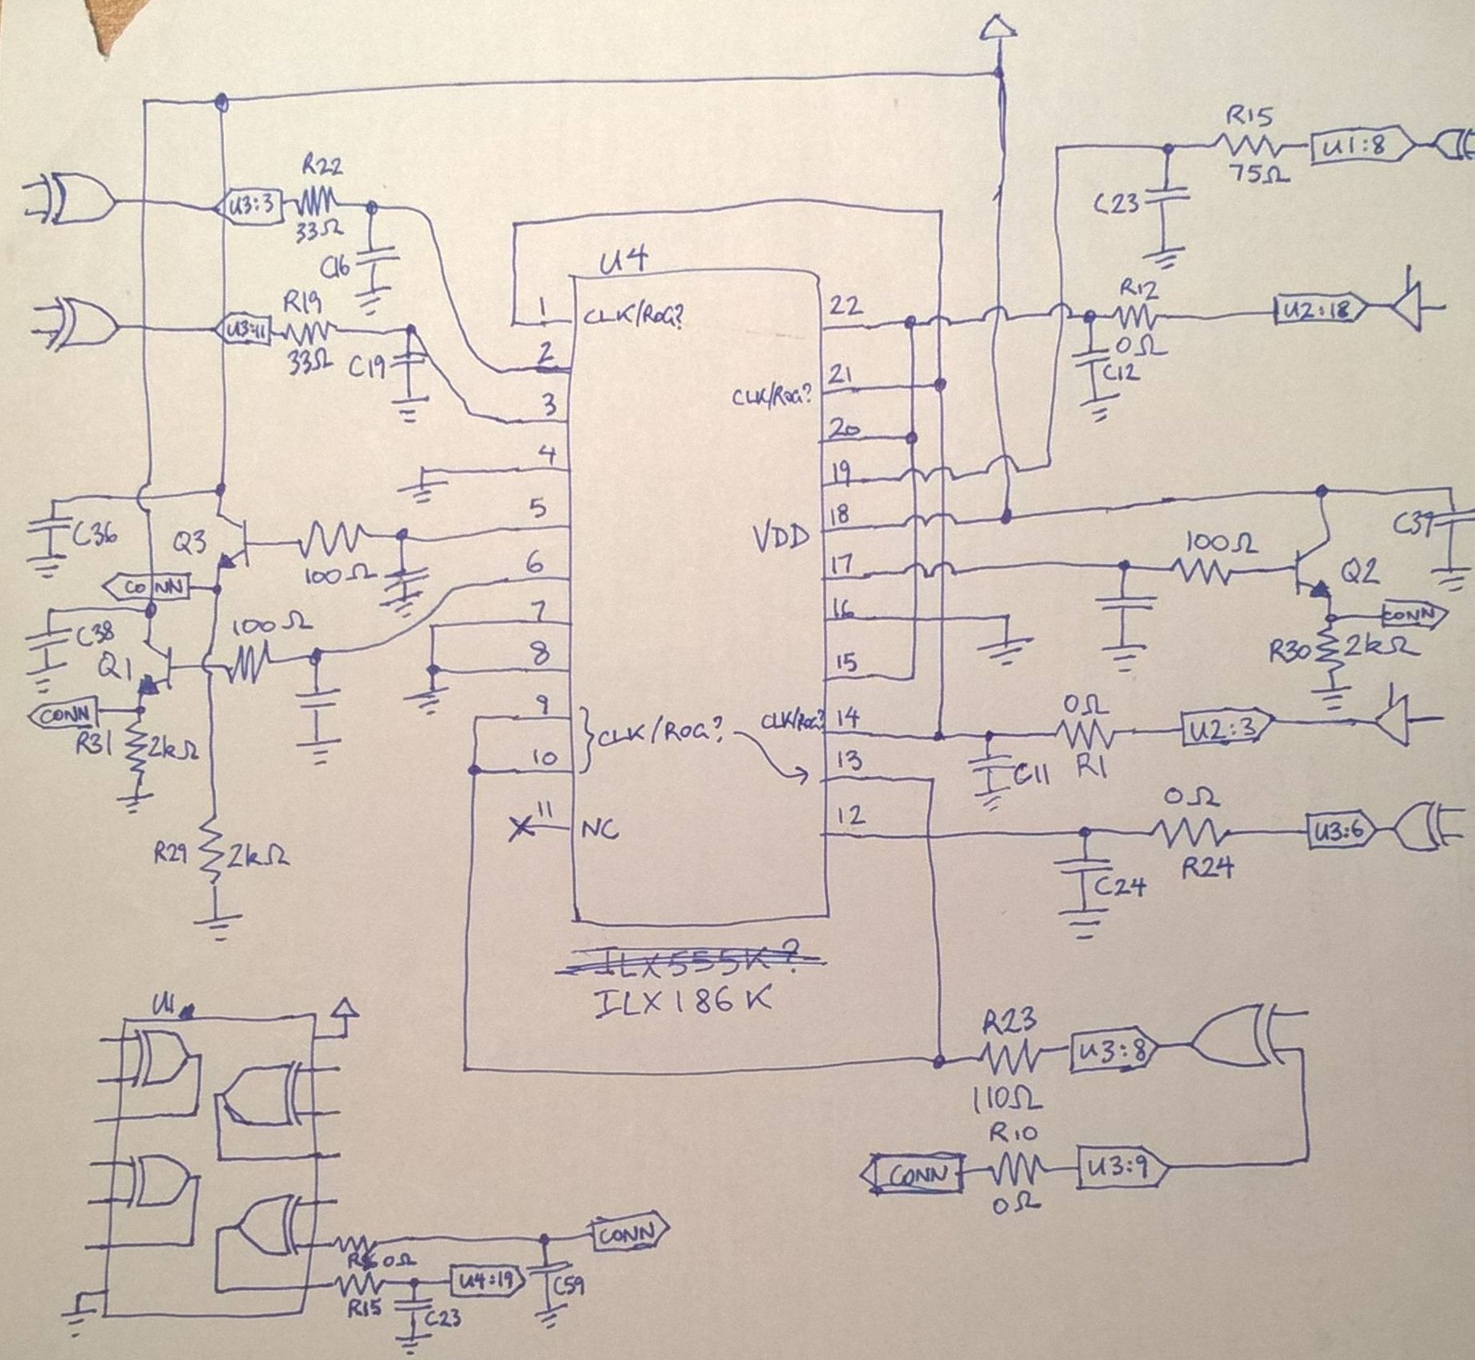
Video activated relay circuit diagram

Slide 15

Thanks' for watching

